Slide 1
IPv6 (Introduction and Configuration)
Gandeva Bayu Satrya, ST., MT.
Telkom Institute of Technology
Bandung
April 2013

Slide 2
Need IPv6 ???
In IPv4 we have VLSM/CIDR and NAT.
IPv4 has only about 4.3 billion addresses available—in theory.
There really are only about 250 million addresses that can he assigned to devices.
The fact that there are about 6.5 billion people in the world today. [LAMMLE-2007]
Now, the number of people and devices that connect to networks increases each and every day.
The Next-Generation Internet Protocol – IPV6.

Slide 3
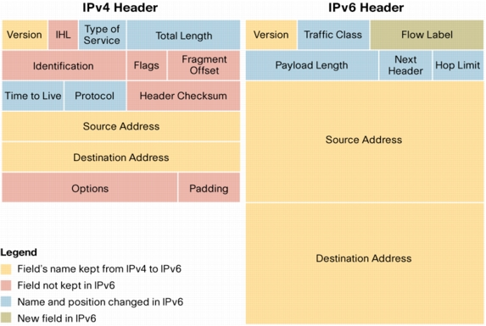
IPv4 and IPv6 Headers

Slide 4
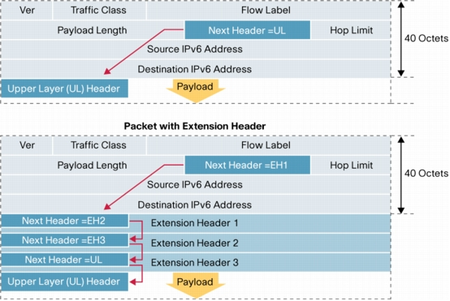
Chaining Extension Headers

Slide 5
IPv6 is…
IPv6, formerly named IPng (next generation), is the latest version of the Internet Protocol (IP).
IP is a packet-based protocol used to exchange data, voice, and video traffic over digital networks.
IPv6 quadruples the number of network address bits from 32 bits (in IPv4) to 128 bits.

Slide 6
Benefits of IPv6
Flexibility
Shortened Expression
Efficiency
A lot of address (3.4x 10³⁸ ≈ definitely enough)
Capability
Migrating to IPV6 (tunnel or dual stack)
Support Security and Mobility
Extension's header IPv6

Slide 7

IPv6 Addressing
Actually 128 bits in length.
The address is expressed in hexadecimal just like a MAC address is, so you could say this address has eight 16-bit hexadecimal colon-delimited blocks.
How about HTTP connection in IPv6?

Slide 8
Address Allocation Policy
/23
/32
/48
/64
2001
0410
Interface ID
Registry
ISP prefix
Site prefix
Bootstrap process - RFC2450
LAN prefix
The allocation process is under reviewed by the Registries:
IANA allocates 2001::/16 to registries
Each registry gets a /23 prefix from IANA
Formely, all ISP were getting a /35
With the new policy, Registry allocates a /32 prefix to an IPv6 ISP
Then the ISP allocates a /48 prefix to each customer (or potentially /64)
ftp://ftp.cs.duke.edu/pub/narten/ietf/global-ipv6-assign-2002-06-26.txt
Notes:
The generic allocation process is:
IANA allocates 2001::/16 to registries from the full address space
Slow-start allocation process:
Each registry gets a /23 prefix from IANA, within the 2001::/16 space
Registry allocates an initial /32 prefix to a new IPv6 ISP
ISP allocates a /48 prefix (out of the /32) to each customer

Slide 9
Interface IDs
Lowest-order 64-bit field of unicast address may be assigned in several different ways:
auto-configured from a 64-bit EUI-64, or expanded from a 48-bit MAC address (e.g., Ethernet address)
auto-generated pseudo-random number (to address privacy concerns)
assigned via DHCP
manually configured
Notes:
Current LANs like Ethernet use 48-bit MAC addresses defined by the IEEE 802 standards. The IEEE has introduced a new, 64-bit address space called EUI-64, for new kinds of LANs. There is a standard mapping from a 48-bit MAC into a 64-bit EUI-64.

Slide 10
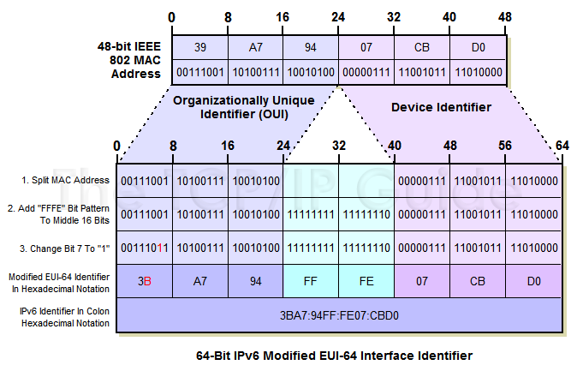
Modified EUI-64 Interface ID

Slide 11
IPv6 Addressing Examples
LAN: 3ffe:b00:c18:1::/64
Ethernet0
interface Ethernet0
ipv6 address 2001:410:213:1::/64 eui-64
MAC address: 0060.3e47.1530
router# show ipv6 interface Ethernet0
Ethernet0 is up, line protocol is up
IPv6 is enabled, link-local address is FE80::260:3EFF:FE47:1530
Global unicast address(es):
2001:410:213:1:260:3EFF:FE47:1530, subnet is 2001:410:213:1::/64
Joined group address(es):
FF02::1:FF47:1530
FF02::1
FF02::2
MTU is 1500 bytes

Slide 12
Shortened Expression
Example 1:
before = 2001:db8:3c4d:12:0:0:1234:56ab
after = 2001:db8:3c4d:12::1234:56ab
Example 2:
before = 2001:0000:0000:0012:0000:0000:1234:56ab
before = 2001::0012::1234:56ab (WRONG)
before = 2001::0012:0000:0000:1234:56ab (RIGHT)
before = 2001:0000:0000:0012::1234:56ab (RIGHT)

Slide 13
More on IPv6 Addressing
80 bits
16 bits
32 bits
0000……………………………0000
0000
IPv4 Address
IPv6 Addresses with Embedded IPv4 Addresses
80 bits
16 bits
32 bits
0000……………………………0000
FFFF
IPv4 Address
IPv4 mapped IPv6 address

Slide 14
Address Type
We're all familiar with IPv4’s unicast, broadcast, and multicast addresses that basically define who or at least how many other devices we're talking to.
IPv6 adds to that trio and introduces the anycast. Broadcasts, as we know them, have been eliminated in IPv6 because of their cumbersome inefficiency.
Type of IPv6 Addressing
Unicast , Global Unicast Addresses, Link-local Addresses, Unique Local Addresses, Multicast, and Anycast

Slide 15
Types of IPv6 Addresses
Unicast
Address of a single interface
Delivery to single interface
Multicast
Address of a set of interfaces
Delivery to all interfaces in the set
Anycast
Address of a set of interfaces
Delivery to a single interface in the set
No more broadcast addresses

Slide 16
Discovery Protocol
The process of resolving a destination’s IP address to that destination’s MAC address is referred to as, unsurprisingly, address resolution.
In IPv4. this task is performed by the Address Resolution Protocol (ARP). In IPv6, this function is performed by the Neighbor Discovery protocol (ND).

Slide 17
IPv6 Neighbor Discovery
Neighbor discovery is a function that enables a node to identify other hosts and routers on its links.
The node needs to know of at least one router so that it knows where to forward packets if a target node is not on its local link.
Neighbor discovery also allows a router to redirect a node to use a more appropriate router if the node has initially made an incorrect choice.
There are two ways that neighbor discovery are performed in IPv6. Statelessly via ICMPv6 and Statefuly via DHCPv6.

Slide 18
IPv6 ND Messages
Type 133 Router Solicitation Message
Type 134 Router Advertisement Message
Type 135 Neighbor Solicitation Message
Type 136 Neighbor Advertisement Message
Type 137 Neighbor Redirect Message

Slide 19
ICMPv6
In order for IP to move data from one node to another successfully, there are many functions that need to be carried out, (error reporting, route discovery, and diagnostics) to name a few. These tasks are carried out by Internet Control Message Protocol
ICMPv6 also carries out the tasks of conveying multicast group membership information, (a function that was previously performed by the IGMP protocol in IPv4), and address resolution, (previously performed by ARP).
ICMPv6 messages and their use are specified in RFC 4443 – Internet Control Message Protocol (ICMPv6) for the Internet Protocol Version 6 (IPv6) and RFC 2461 – Neighbor Discovery for IP Version 6 (IPv6). Both RFCs are draft standards with a status of elective.
Every ICMPv6 message is preceded by an IPv6 header (and possibly some IP extension headers). The ICMPv6 header is identified by a Next Header value of 58 in the immediately preceding header.

Slide 20
ICMPv6
There are two classes of ICMPv6 messages.
Error messages Type 0 to 127.
Informational messages Type 128 to 255.

Slide 21
Migration Techniques
A wide range of techniques have been identified and implemented, basically falling into three categories:
(1) dual-stack techniques, to allow IPv4 and IPv6 to co-exist in the same devices and networks
(2) tunneling techniques, to avoid order dependencies when upgrading hosts, routers, or regions
(3) translation techniques, to allow IPv6-only devices to communicate with IPv4-only devices
Expect all of these to be used, in combination

Slide 22
Ex 1: 6to4 Tunnel
2002:8243:1::/48
2002:947A:1::/48
IPv6
IPv4
IPv6
130.67.0.1
148.122.0.1
11.0.0.1
6to4 prefix is 2002::/16 + IPv4 address. 2002:a.b.c.d::/48
IPv6 Internet
6to4 relay 2002:B00:1::1 Announces 2002::/16 to the IPv6 Internet

Slide 23
Ex 2: Configured Tunnel
3ffe:c00:2::/48
3ffe:c00:1::/48
IPv4
IPv6
IPv6
130.67.0.1
148.122.0.1
-------------------------------------- |IPv4 header|IPv6 header IPv6 payload| -------------------------------------- IPv4 protocol type = 41

Slide 24
Ex 3: Automatic Tunnel
130.67.0.1 ::130.67.0.1
148.122.0.1 ::148.122.0.1
IPv6
IPv4
IPv6
Connects dual stacked nodes
Quite obsolete
IPv6 Internet

Slide 25
Routing in IPv6
As in IPv4, IPv6 has 2 families of routing protocols: IGP and EGP, and still uses the longest-prefix match routing algorithm
IGP
RIPng (RFC 2080)
Cisco EIGRP for IPv6
OSPFv3 (RFC 2740)
Integrated IS-ISv6 (draft-ietf-isis-ipv6-02)
EGP : MP-BGP4 (RFC 2858 and RFC 2545)
IOS more than 12.4

Slide 26
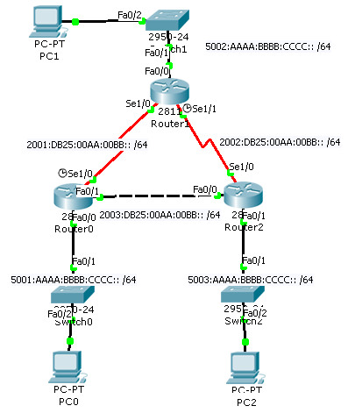
RIPng Configuration
Router0# sh run
!
ipv6 unicast-routing
!
interface FastEthernet0/0
ipv6 address 5001:AAAA:BBBB:CCCC::/64 eui-64
ipv6 rip RT0 enable
!
interface FastEthernet0/1
ipv6 address 2003:DB25:AA:BB::/64 eui-64
ipv6 rip RT0 enable
!
interface Serial1/0
no ip address
ipv6 address 2001:DB25:AA:BB::/64 eui-64
ipv6 rip RT0 enable
clock rate 9600
!
!
ipv6 router rip RT0
!

Slide 27
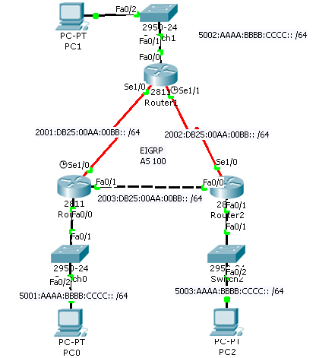
EIGRP for IPv6 Configuration
Rouyter0# sh run
!
ipv6 unicast-routing
!
interface FastEthernet0/0
ipv6 address 5001:AAAA:BBBB:CCCC::/64 eui-64
ipv6 eigrp 100
ipv6 enable
!
interface Serial1/0
no ip address
ipv6 address 2001:DB25:AA:BB::/64 eui-64
ipv6 eigrp 100
ipv6 enable
clock rate 9600
!
!
ipv6 router eigrp 100
router-id 1.1.1.1
no shutdown
!

Slide 28
OSPFv3 Configuration
Router1#
interface Ethernet0
ipv6 address 2001:1:1:1::1/64
ipv6 ospf 1 area 0
interface Ethernet1
ipv6 address 2001:2:2:2::2/64
ipv6 ospf 1 area 1
ipv6 router ospf 1
router-id 1.1.1.1
area 1 range 2001:2:2::/48
Area 0
Router2
LAN1: 2001:1:1:1::/64
Eth0
Router1
Eth1
LAN2: 2001:2:2:2::/64
Area 1

Slide 29
IS-IS dual IP configuration
Router1#
interface ethernet-1
ip address 10.1.1.1 255.255.255.0
ipv6 address 2001:0001::45c/64
ip router isis
ipv6 router isis
interface ethernet-2
ip address 10.2.1.1 255.255.255.0
ipv6 address 2001:0002::45a/64
ip router isis
ipv6 router isis
router isis
address-family ipv6
redistribute static
exit-address-family
net 42.0001.0000.0000.072c.00
redistribute static
LAN1: 2001:0001::45c/64
Ethernet-1
Router1
Ethernet-2
LAN2: 2001:0002::45a/64
Dual IPv4/IPv6 configuration.
Redistributing both IPv6 static routes
and IPv4 static routes.

Slide 30
A Simple MP-BGP Session
Router2
Router1
AS 65001
AS 65002
3ffe:b00:c18:2:1::F
3ffe:b00:c18:2:1::1
Router1#
interface Ethernet0
ipv6 address 3FFE:B00:C18:2:1::F/64
!
router bgp 65001
bgp router-id 10.10.10.1
no bgp default ipv4-unicast
neighbor 3FFE:B00:C18:2:1::1 remote-as 65002
address-family ipv6
neighbor 3FFE:B00:C18:2:1::1 activate
neighbor 3FFE:B00:C18:2:1::1 prefix-list bgp65002in in
neighbor 3FFE:B00:C18:2:1::1 prefix-list bgp65002out out
exit-address-family
Notes:
Establish on top of IPv4 or IPv6
BGP4 independant of the transport
BGP id : not an IPv4 address (should be only)

Slide 31
References
[1] RAJEEV S. KOODLI and CHARLES E. PERKINS, MOBILE INTER-NETWORKING WITH IPv6 : Concepts, Principles, and Practices, John Wiley & Sons, Inc., Hoboken, New Jersey. 2007.
[2] Silvano Gai, Internetworking IPv6 with Cisco Routers, McGraw-Hill.
[3] Todd Lammle, CCNA : Cisco Certified Network Associate Study Guide 6th Edition, Wiley Publishing, Inc., Indianapolis, Indiana, 2007.

Slide 32
Wahai anak muda, jika Engkau tidak sanggup menahan lelahnya belajar, engkau harus menanggung pahitnya kebodohan. ~Pythagoras~
Thank You.
Bandung, April 27th 2013
Gandeva Bayu Satrya, ST., MT.

